Slide 1
Real Estate Buyer’s offer tool Bot Using Machine Learning

Slide 2
Scenario
We are approached by our same client. She has decided that instead of investing in stocks, she wants to invest in the housing market in Seattle.
She wants to know what would be a competitive offer for buying a desirable piece of real estate.
We created a tool to assist our client in making a competitive offer

Slide 3
User Story and acceptance Criteria
As a real estate investor, I want to find a way to make a competitive offer based on historical data that takes into consideration site/dwelling features so that my offer is the most desirable to the seller.
Given the analysis of the Seattle market, we will create a bot that will recommend an offer amount based on the best machine learning model and how aggressive the client wants to make their offer.

Slide 4
Method
We will analyze 5 years of historical data from May 2017 to May 2022, in Seattle, using three different types of machine learning models: Decision Tree, Random Forest, and Linear Regression.
Specific features include Zip Code, Bathrooms, Bedrooms, Lot Square Footage, Listing Price, Sold to List Price Percentage, Square Footage, and Property Type
We will then use the analysis to determine the best machine learning model to use in our lex bot
The bot will then suggest an offer price that our client would offer for a property based on our model and user input.

Slide 5
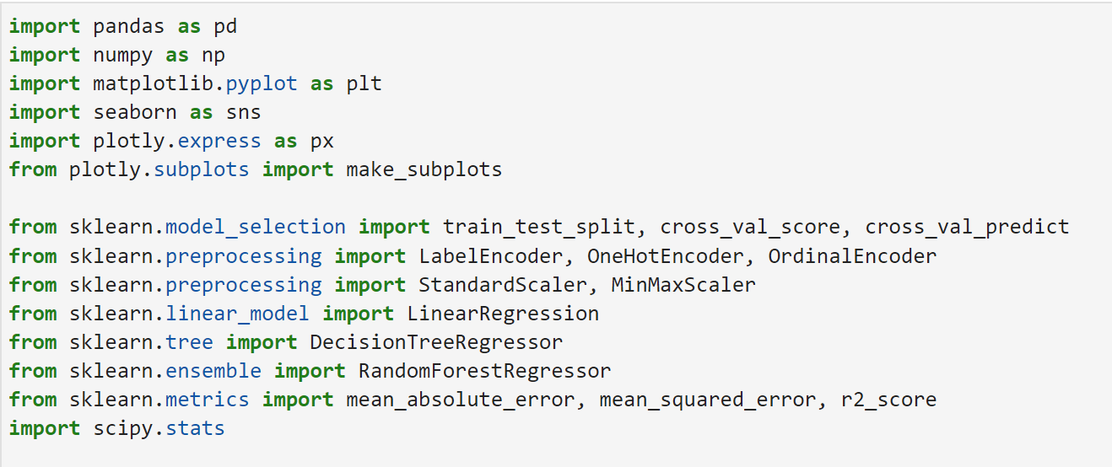
Technologies - Imports

Slide 6
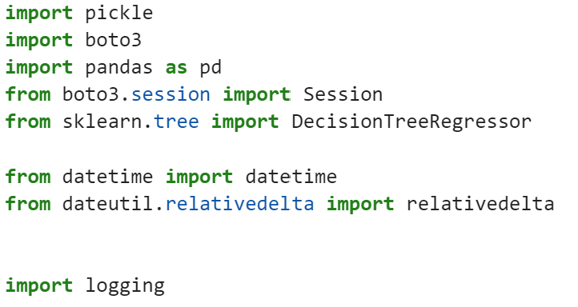
Technologies - Imports For Lambda Function

Slide 7
Technologies - AWS
Lambda
S3
Lex Bot
Cloud Watch

Slide 8
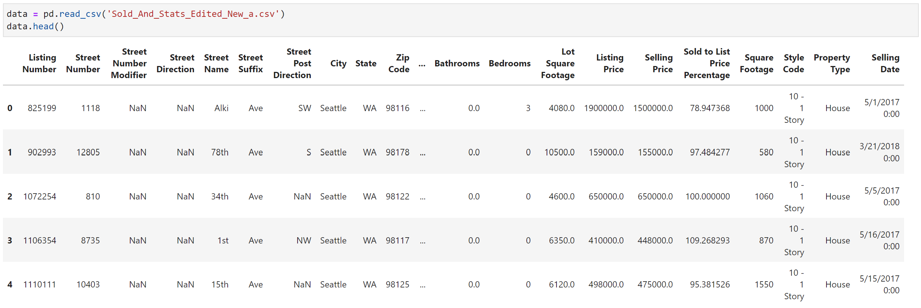
Data Frame (Raw)

Slide 9
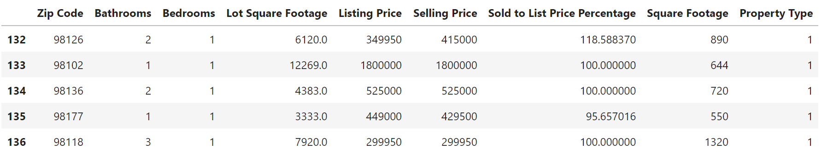
Data Frame (Cleaned)

Slide 10
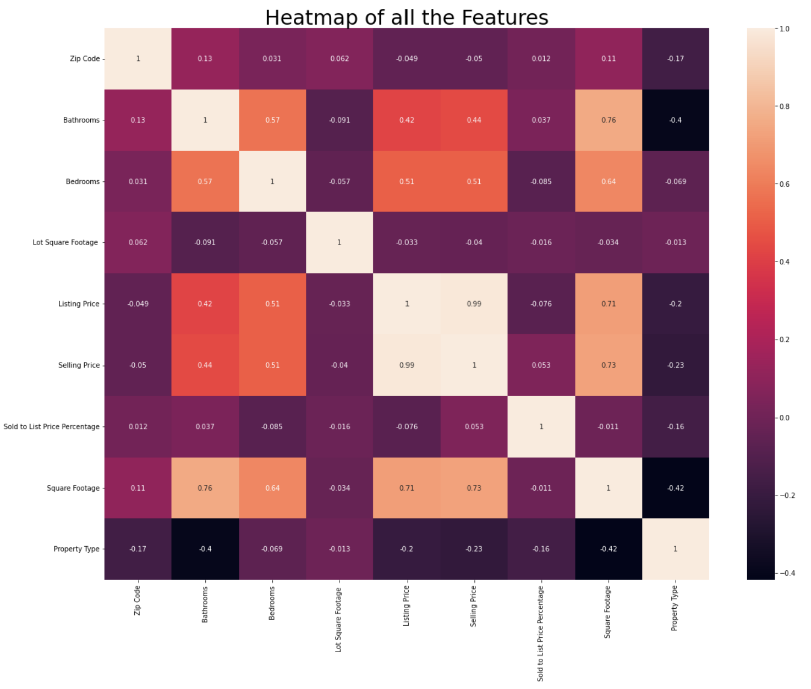

Slide 11
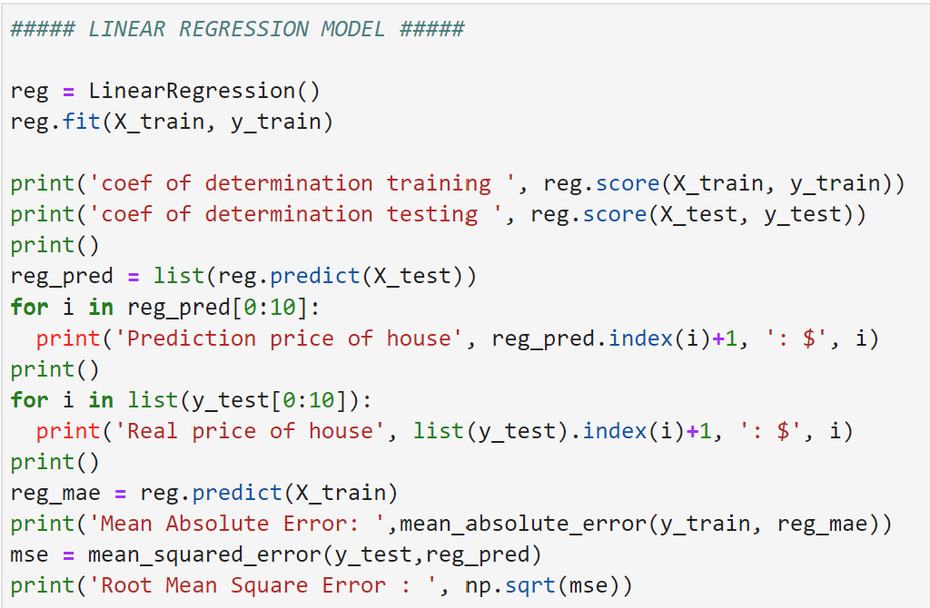
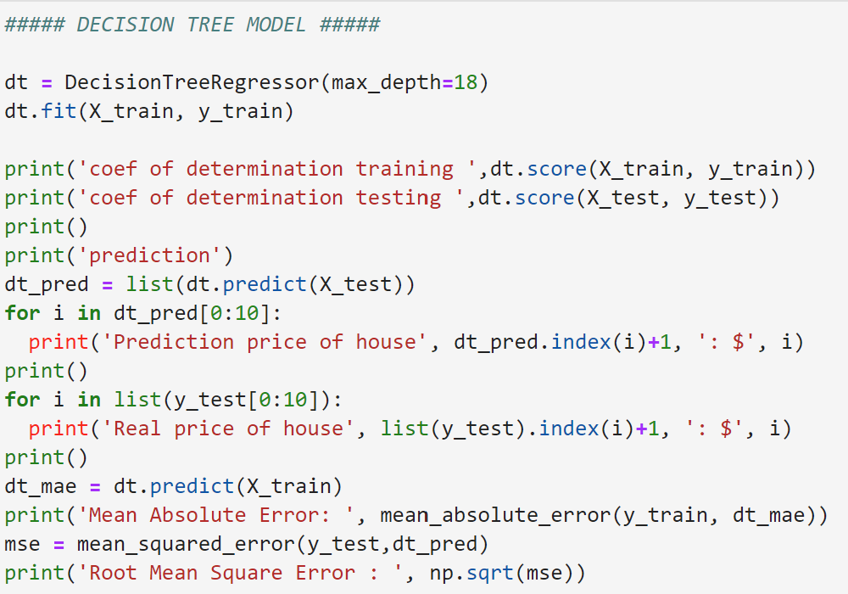
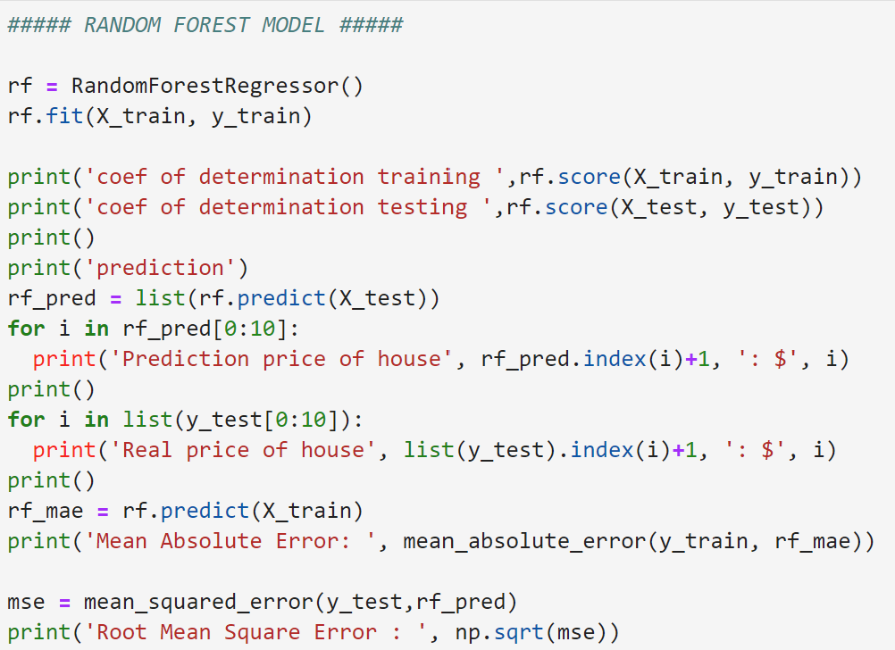
Code For Models

Slide 12

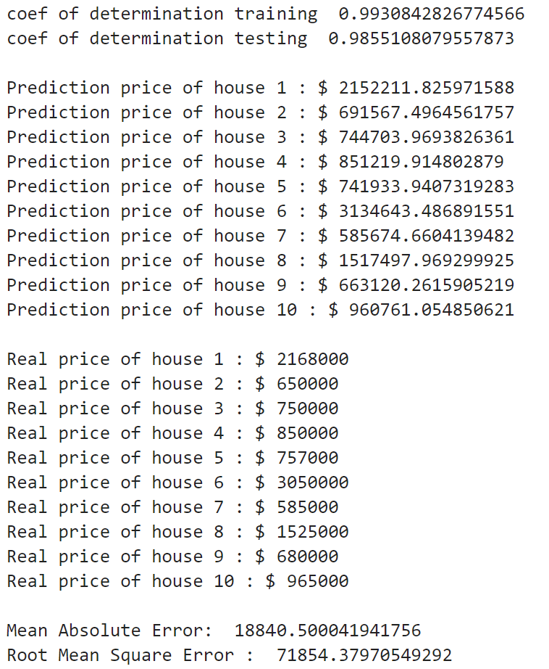
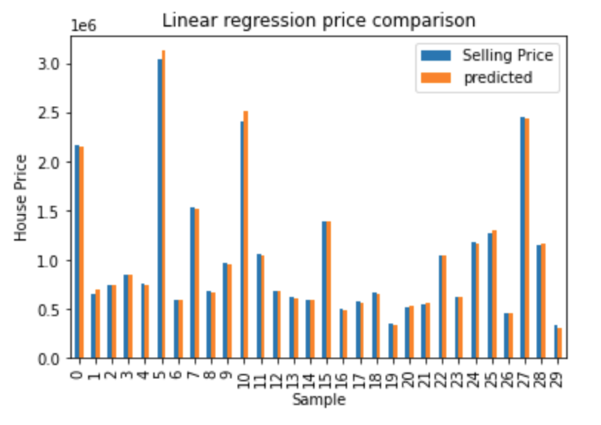
Linear Regression Model Results

Slide 13
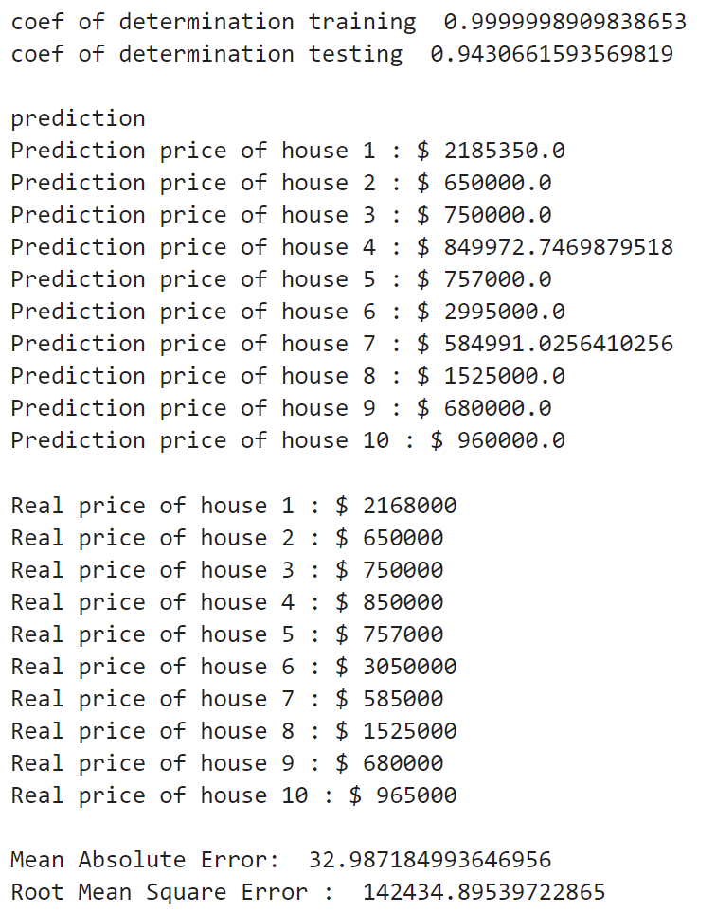
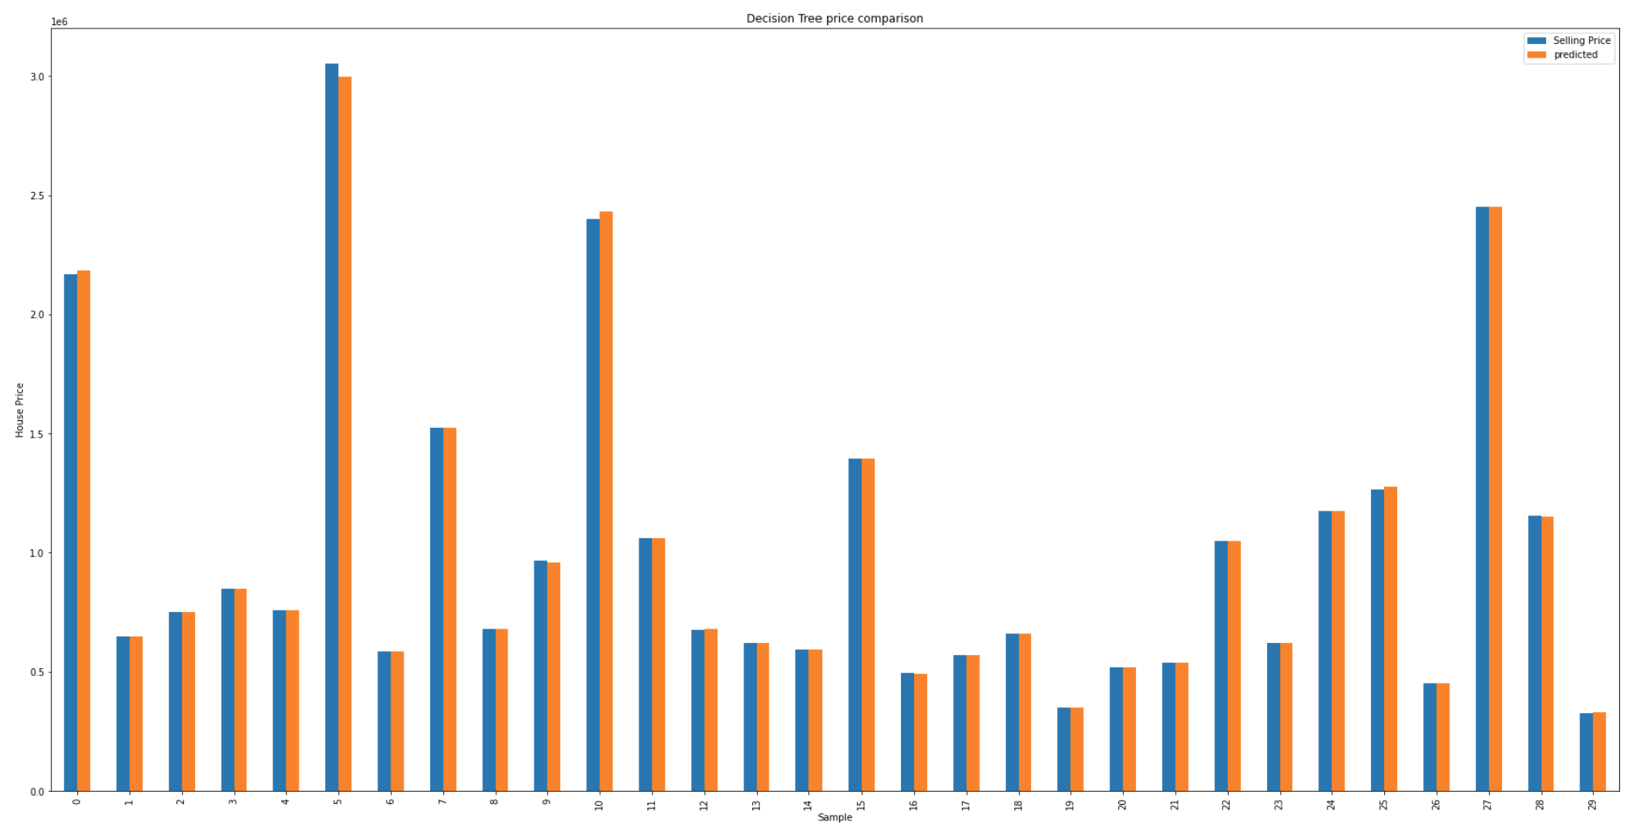
Decision Tree Model Results

Slide 14
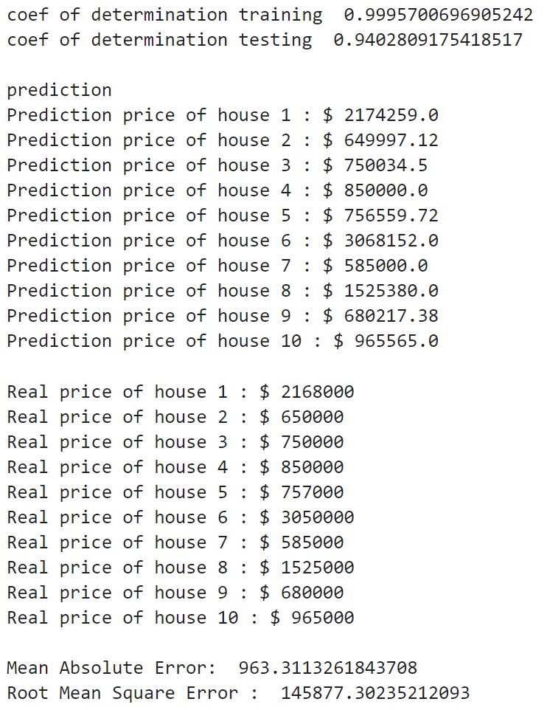

Random Forest Model Results

Slide 15
Analysis
Based on the Mean Absolute Error, we chose to use the Decision Tree Model with our lex bot
Decision trees support non linearity, where LR supports only linear solutions. When there are a large number of features with fewer data-sets (with low noise), linear regressions may outperform Decision trees/random forests. In general cases, Decision trees will have better average accuracy.

Slide 16
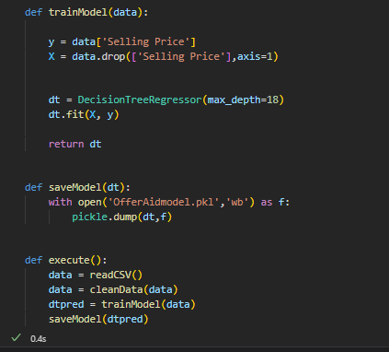
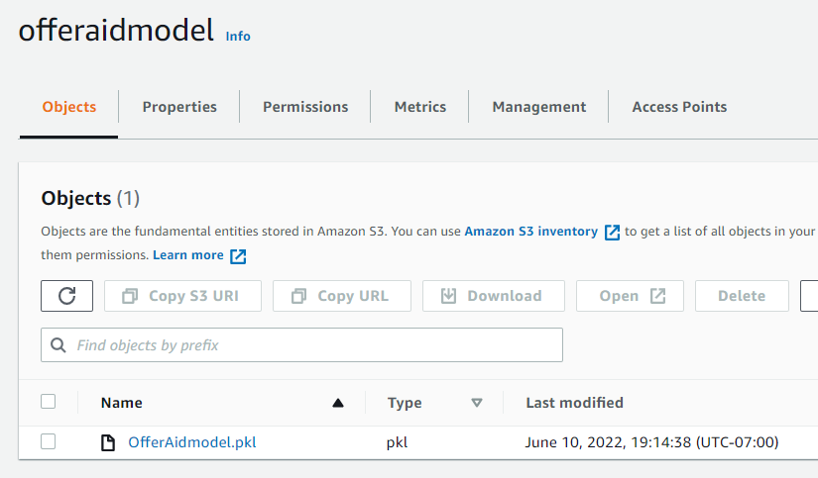
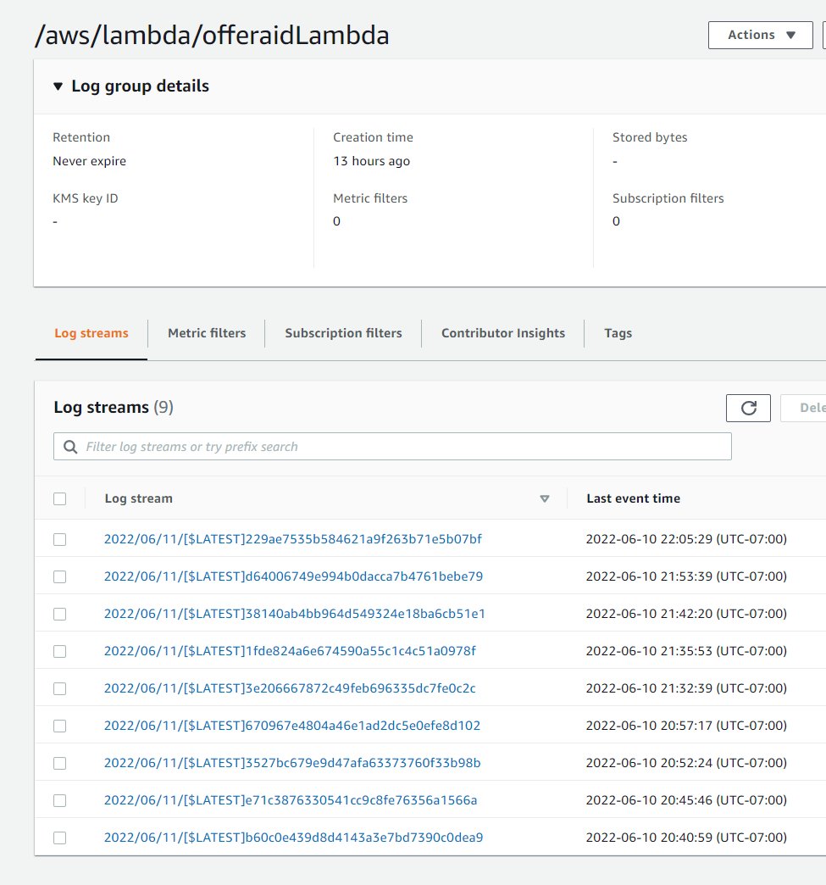
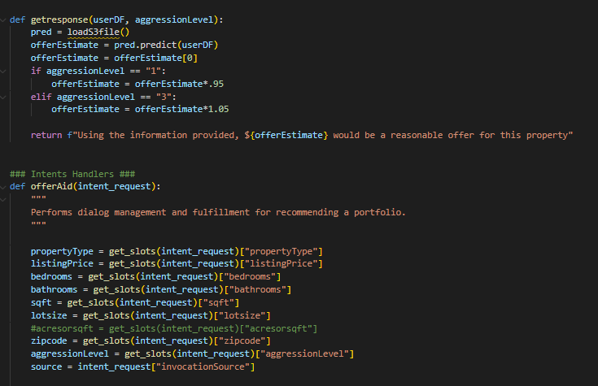
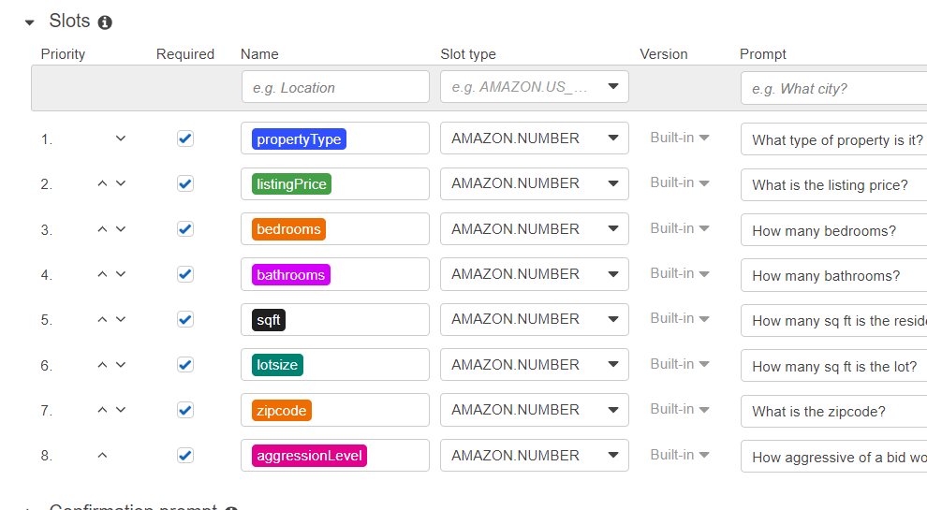
Structuring and Deploying the Code on AWS
Step 1: Building the
Prediction Model and
Lambda Code
Step 2: Storing trained
Prediction model in AWS,
Building Lex intent
Step 3: Troubleshooting
Compatibility Issues,
Permissions, Lambda Layers,
compromised access keys

Slide 17
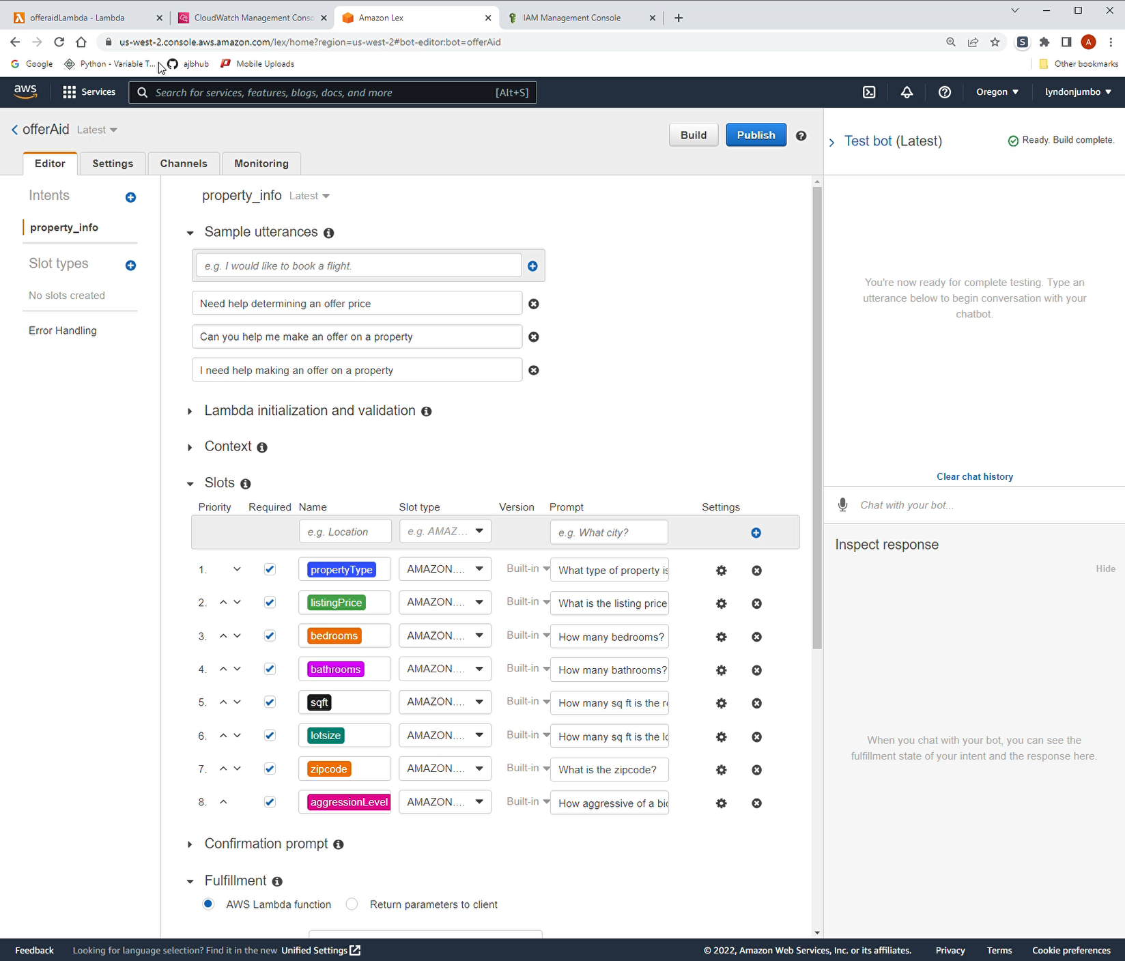
Full Application With Bot

Slide 18
Conclusion
The bot we have created enables users to, after having supplied desired features, give accurate offers for real estate in the Seattle area.

Slide 19
Limitations and Next Steps
Real estate is an everchanging market that can be hard to predict, with prices that can be based as much on feel as on clear data points.
There simply is not enough data for an algorithm to learn about longer real estate busts and booms.
The prediction model doesn't account for emotional/sentimental values. For example, some people will pay more money to purchase a childhood home or a home close to family.
We could expand the area outside Seattle, but in order to do so, we would need more data. Until that data is procured, the model accuracy only works for Seattle zip codes

Slide 20
Contributors
Cody Schroeder, codeman@uw.edu
Hilary Willis, hilarywillis@gmail.com
Theo Prentice, theoprentice14@gmail.com
Aaron Bumgarner, aaron.j.bumgarner@gmail.com
Aranda Furth, arandafurth@gmail.com

